Slide 1
A-Topics: Topic 7
Knowledge Translation: Using Tools to Facilitate Communication with Patients
Scientific Panel Lecturer: Carolyn Jack Community panelist : Marissa Joseph Affiliations: UNIVERSITY OF TORONTO

Slide 2
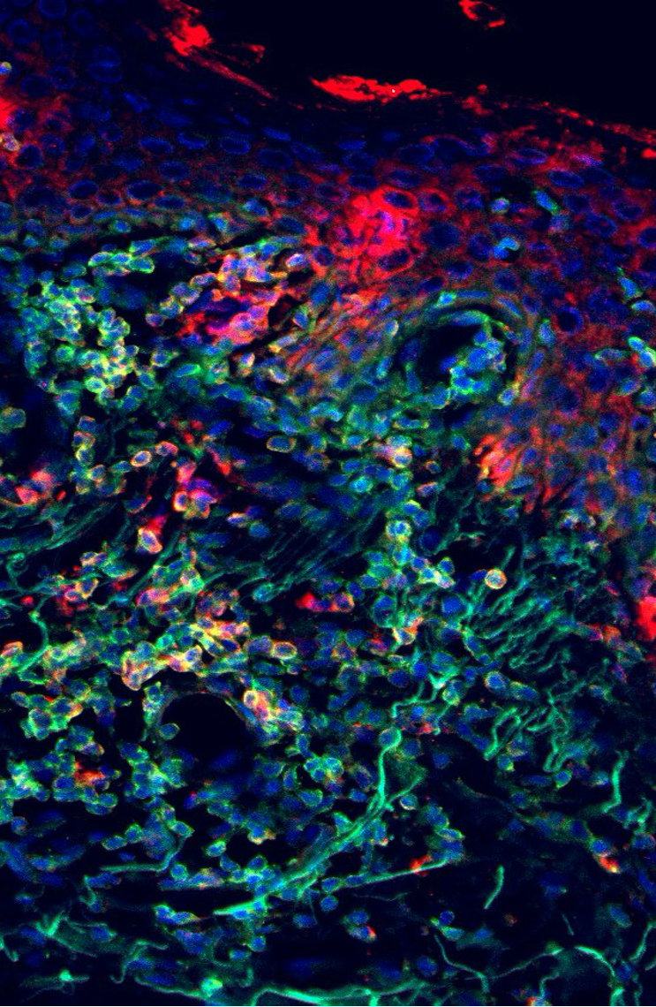
Disclosures
Faculty/Presenter: Marissa Joseph
Relationships with for-profit and/or non-profit organizations:
Grant/Research Support: N/A
Speakers Bureau/Honoraria: Loreal, Sanofi, Janssen, Abbvie, Pfizer, Johnson & Johnson, Incyte, Sunpharma, Bausch Health, Amgen, Bristol Myers Squibb, Lilly
Other: N/A

Slide 3
Key points for: Dermatology Trainees
Quality of life (QOL) impact in patients who have atopic dermatitis (AD)
There is a significant negative impact on wellbeing in patients with AD stemming from the unstable, unpredictable, and unbearable nature of the disease.
The pruritus and sleep disturbance are hallmark features AD which drive the mental health challenges experienced by these patients.
There is a significant financial cost, and stigmatization experienced by patients who have AD.
Approach to addressing mental health sequelae in patients with AD
Addressing mental health is a part of eczema management.
The first step is continued pursuit of better disease control of AD
Approaches can include elements of self care (identifying needs) and resiliency (reflection). This helps patients restructure thoughts and perspectives with positive thoughts and actions.
Evidence-based interventions for mental health sequelae in patients with AD
There are few criteria to guide mental health interventions in patients who have AD, as mental health recommendations are not consistently addressed in clinical practice guidelines.
Interventions can include psycho-pharmacotherapy, psychotherapy, and behavioral management such as sleep hygiene and physical exercise.
A pilot program evaluating wellness intervention via group support programming highlighted the need for accessible, and practical programs. There is a large variance in available online eczema apps and most do not conform with practice guidelines to support evidence based self management.

Slide 4
Key points for: General Practitioners
Atopic dermatitis (AD) is not just a skin disease
There is a significant negative impact on wellbeing in patients with AD stemming from the unstable, unpredictable, and unbearable nature of the disease.
The pruritus and sleep disturbance are hallmark features AD which can drive the mental health challenges experienced by these patients, including anxiety and depression.
There is a significant financial cost, and stigmatization experienced by patients who have AD.
Approach to addressing mental health sequelae in patients with AD
Addressing mental health is a part of eczema management.
It is essential to pursue better disease control of AD.
Approaches can include elements of self care (identifying needs) and resiliency (reflection). This helps patients restructure thoughts and perspectives with positive thoughts and actions.
Evidence-based interventions for mental health sequelae in patients with AD
There are few criteria to guide mental health interventions in patients who have AD, as mental health recommendations are not consistently addressed in clinical practice guidelines.
Interventions can include peer support programs, psycho-pharmacotherapy, psychotherapy, and behavioral management such as sleep hygiene and physical exercise.
Similar to patients with chronic pain, psychotherapy interventions include cognitive behavioral therapy (CBT), acceptance/commitment therapy, mindfulness, habit reversal training , breathing and deep muscle relaxation.

Slide 5
Key points for: Adult-Adolescent Patients
Atopic dermatitis (AD) is not just a skin disease
There is a significant negative impact on wellbeing in patients with AD stemming from the unstable, unpredictable, and unbearable nature of the disease.
It is important to discuss the impact of AD on your sleep, mood and quality of life with your health care team.
The scientific community is interested in exploring from research into how AD affects patients lives, and how best to improve the negative effects on wellbeing.
Improving mental health in patients with AD
Addressing mental health is a part of eczema management.
Good disease control is important.
Approaches can include elements of self care (identifying needs) and resiliency (reflection) to restructure thoughts and perspectives with positive thoughts and actions.
Evidence-based interventions to address mental health in patients with AD
Many online resources or apps do not meet standards for evidence based self management of atopic dermatitis. It is important to find quality apps and resources.
Interventions can include peer support programs, medication, talk-therapy, and behavioral management such as sleep hygiene and physical exercise.
Just like patients with chronic pain, is important to discuss tools and management of mental health with your care team, and possibly consider specific types of therapy with a qualified therapist.
.

Slide 6
What added information is needed for… ?
Dermatology Trainees (e.g. for a fellowship curriculum)
Appropriate screening tools (anxiety, depression)
Overview of pharmacotherapies (prescribed by others)
Comfort prescribing advanced therapies
General practitioners (e.g. For an accredited course)
Data on burden of AD on patients, highlighting mental health including suicidality
Overview of advanced therapies
Overview of pharmacotherapies relevant and effective in this pt population, and available tools and supports ie (Eczema Q)
Adult-adolescent patients (e.g. for an Eczema school)
Disease education
Treatment and symptom management education
Specific wellness strategies, and available resources, tools (ie EczemaQ)

Slide 7
Three points most relevant to my practice?
Impact on QOL
Acknowledging mental health as part of eczema management, this an important unmet need, most apps do not meet clinical guidelines
Persistence of mental health sequelae even during AD disease remission
Points relevant to my practice not found and/or irrelevant info?
Resources, how to address anxiety/depression without a comfort in pharmacotherapy such as SSRIs etc
Network for mental health supports, what is available and whom to send where
Context/ consideration for younger pediatric patients and their caregivers whose mental health are significantly impacted by AD

Slide 8
Prepare 2-3 post-video questions for derm trainees (Multiple choice, true/false, and/or short-answer questions from topic)
Question 1:
True or False. Sleep hygiene and physical exercise should be recommended in adult patients who are significantly affected by atopic dermatitis. True.
Question 2:
True or False. In a Montreal cohort of 207 patients with AD 10% of patients had no disease remission in previous year. False. (1/3 patients)
Question 3: Name 3 types of psychotherapy that may be beneficial in patients affected by atopic dermatitis? 1)cognitive behavioral therapy (CBT), 2) acceptance/commitment therapy, 3) mindfulness, 4) habit reversal training , 5)breathing and deep muscle relaxation.

Slide 9
Key Takeaway: Vote via Annotation
Quality of life (QOL) impact in patients who have atopic dermatitis (AD)
Approach to addressing mental health sequelae in patients with AD
Evidence-based interventions for mental health sequelae in patients with AD

