Slide 1
Novel systemic therapies for the treatment of AD MUHC’s Centre of Excellence in AD
Melinda Gooderham MSc MD FRCPC
SKiN Centre for Dermatology, Peterborough
Assistant Professor, Queen’s University, Kingston ON
Investigator, Probity Medical Research, Waterloo ON
2021
2021

Slide 2
Speaker Disclosures
Advisory Board/PI/ Investigator/Speaker/Consultant:
AbbVie Inc., Akros Pharma Inc. Amgen, Arena Pharmaceuticals, Arcutis Pharmaceuticals Inc., Aristea, Asana Bio Sciences, AnaptysBio, Bausch Health, Boehringer Ingelheim International, Bristol Myers Squibb, Celgene, Coherus Biosciences, Dermavant, Dermira Inc., Eli Lilly, Galderma SA., GSK, Janssen Inc., Kyowa Kirin, LEO Pharma, MedImmune, Merck & Co., Meiji, Moonlake, Novartis Pharmaceuticals, Nimbus Therapeutics, Pfizer Inc., Regeneron, Reistone, Sanofi Genzyme, Sun Pharmaceuticals, and UCB.

Slide 3
Objectives
At the end of this session, participants will be able to:
Determine who is the best candidate for systemic therapy
Explore the use systemic therapies in AD
Gain insights on novel systemic therapies

Slide 4
2022 EuroGuiDerm Guideline for adults with AD
Continue measures recommended below and select from (if appropriate):
↑↑
ABRO^{b}
↑↑
BARI^{b}
↑↑
DUPI^{b}
↑↑
CyA^{a,b}
↑↑
TRALO^{b}
↑↑
UPA^{b}
Severe
↑
AZA^{a,c}
↑
MTX^{a,c}
↑
Systemic glucocorticosteroids^{b}
Only as rescue therapy
Continue measures recommended below and select from (if appropriate):
Moderate
↑↑
TCS^{b}
↑↑
TCI^{b}
↑↑
NB-UVB and medium dose UVA1
↑↑
Psychosomatic counseling
Proactive
Proactive
Continue measures recommended below and select from (if appropriate):
Mild
↑↑
TCS^{b}
↑↑
TCI^{b}
↑↑
Wet wraps
Acute
Reactive
Acute
Baseline therapy
↑↑
Emollients
↑↑
Avoidance of allergens
↑↑
Educational programs
Daily, in sufficient quantity, and adjust frequency to degree of skin dryness
As much as possible in sensitized patients
ªRefer to guideline text for restrictions. ^{b}Licensed indication. ^{c}Off-label treatment AZA, azathioprine; BARI, baricitinib; CyA, ciclosporin; DLQI, Dermatology Life Quality Index; DUPI, dupilumab; EASI, Eczema Area and Severity Index; MTX, methotrexate; NB-UVB, narrow-band ultraviolet B; TCI, topical calcineurin inhibitor; TCS, topical corticosteroid; TRALO, tralokinumab; UPA, upadacitinib; UVA1, ultraviolet A1 1. EuroGuiDerm Guideline on Atopic Eczema Version 1.0, June 2022. Available at: https://www.edf.one/home/Guidelines/EuroGuiDerm-2022.html (last accessed June 2022); 2. Agenzia Italiana Del Farmaco (AIFA). Available at: https://www.gazzettaufficiale.it/atto/serie_generale/caricaDettaglioAtto/originario?atto.dataPubblicazioneGazzetta=2021-12-10&atto.codiceRedazionale=21A07160 (last accessed September 2022)
Notes:
Abrocitinib not included “As this approval came through after our consensus conferences”
MoA of JAKs “JAK activity may be more effective than targeting a single cytokine.”
As expected, JAKs and Biologics recommended in severe patients in the algorithm (not moderate) – see below
Heads Up data is included in the UPA section, as is 52-wk data “showing long-term efficacy and safety profiles similar to the 16 week trials”
“In practice, we recommend the same baseline screening and treatment monitoring investigations for all JAK inhibitors. For baseline screening this is a full blood count, renal, liver and lipid profile as well as creatinine phosphokinase levels and hepatitis and TB screen, including a chest radiograph.”
“For monitoring purposes, we recommend a full blood count, renal, liver and lipid profile as well as creatinine phosphokinase level at four weeks into treatment and then three-monthly while on therapy.”

Slide 5
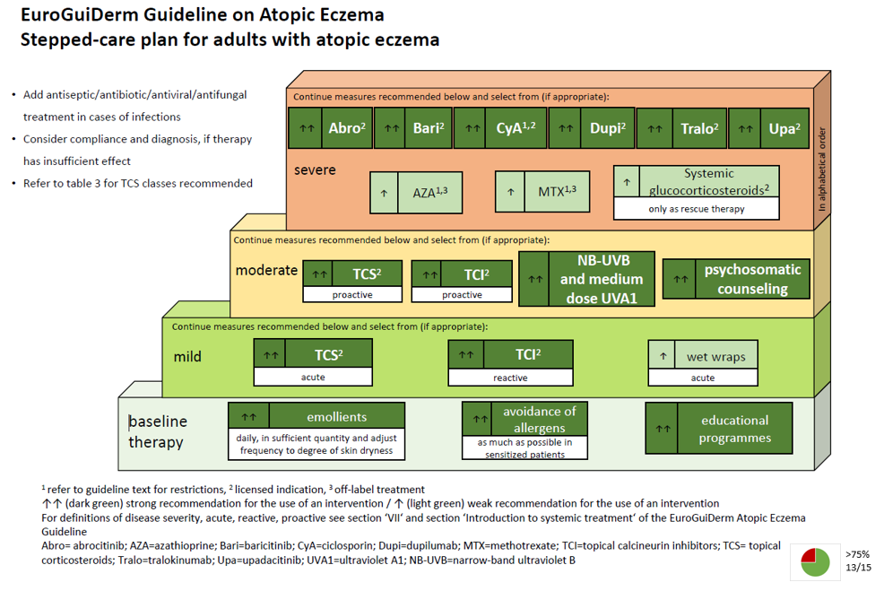

Slide 6
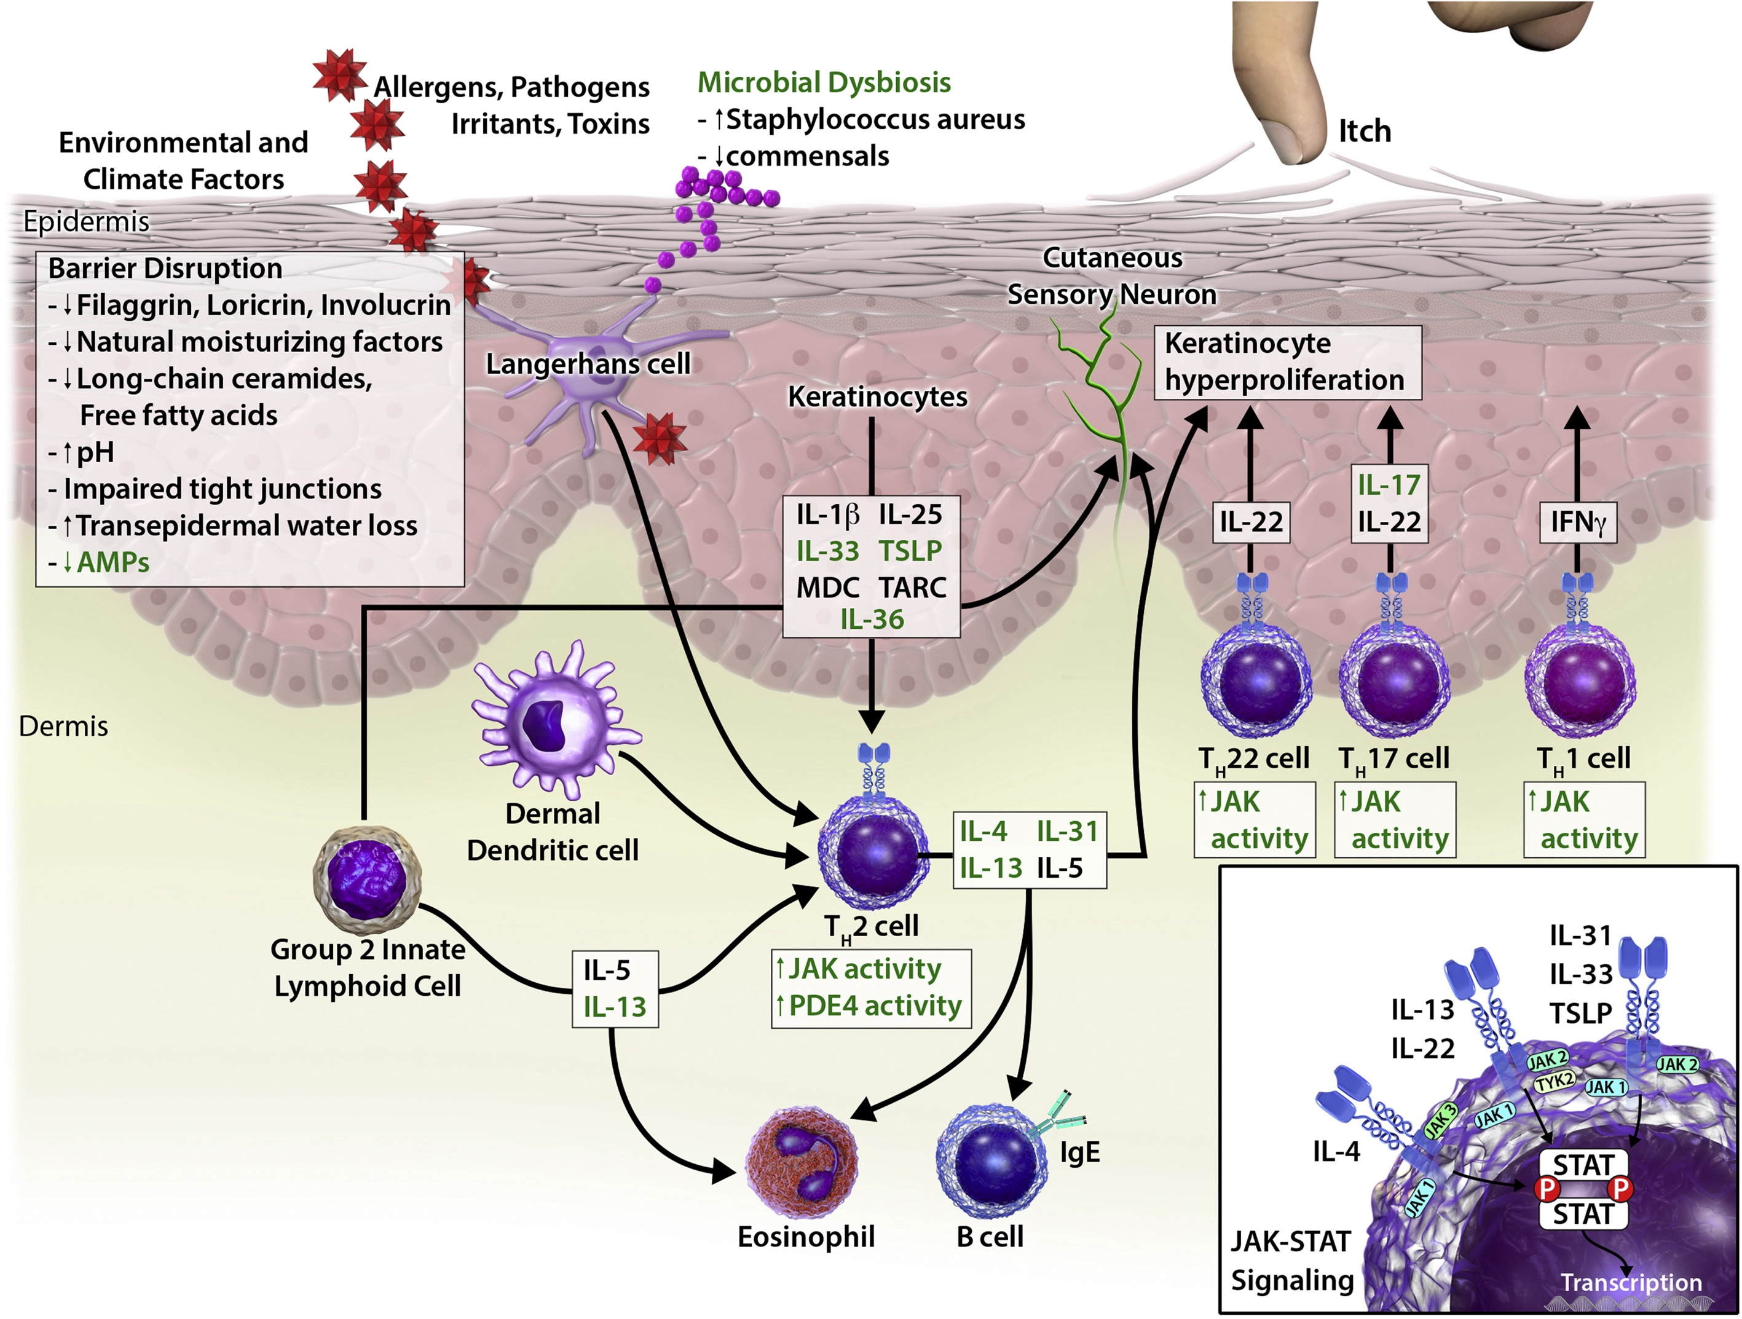
Figure 1
Annals of Allergy, Asthma & Immunology 2021 12621-31DOI: (10.1016/j.anai.2020.08.016)
Copyright © 2020 American College of Allergy, Asthma & Immunology Terms and Conditions
Notes:
Pathogenesis of atopic dermatitis: immune system targets. The epidermis is composed of both immune and nonimmune structural elements that provide a critical barrier for protection against allergens, pathogens, toxins, and irritants and for maintenance of skin hydration. Atopic dermatitis results from dysregulation of these components. Disrupted epidermal barrier function, resulting in increased susceptibility to external insults and increased transepidermal water loss, and immune dysregulation in both the innate and adaptive immune systems (eg, antimicrobial peptides, cytokines, lymphocytes, and other immune cells) contribute to a chronic inflammatory response. Antigen-presenting cells (Langerhans cells, inflammatory dendritic epidermal cells, dermal dendritic cells) and keratinocytes orchestrate the early stages of inflammation upon encountering allergens and other exogenous and endogenous signals. Keratinocyte-produced IL-25, IL-33, IL-36 and TSLP respond to environmental stimuli, including S aureus bacteria, to drive the production of proinflammatory mediators. The resulting type 2 inflammatory response is dominated by TH2 cell activity and group 2 innate lymphoid cells. Cytokines, particularly IL-13, and IL-4 contribute to barrier dysfunction, altered antimicrobial responses, B-cell IgE class switching, and eosinophil recruitment. Cytokine IL-31 is a key mediator of itch, driven by its binding to IL-31 receptors on itch sensory neurons of the dorsal root ganglion and potentiated by IL-4 and IL-13. Increases in IL-22 (produced mainly by TH22 cells) drive keratinocyte hyperproliferation, whereas increases in TH17 and TH1 cell activities are highly variable, based on age and race/ethnicity. The green print highlights targets of novel and emerging therapies. AMP, antimicrobial peptide; IFN, interferon; Ig, immunoglobulin; IL, interleukin; JAK, Janus kinase; PDE4, phosphodiesterase 4; STAT, signal transducer and activator of transcription; TH, T-helper cells; TSLP, thymic stromal lymphopoietin.

Slide 7
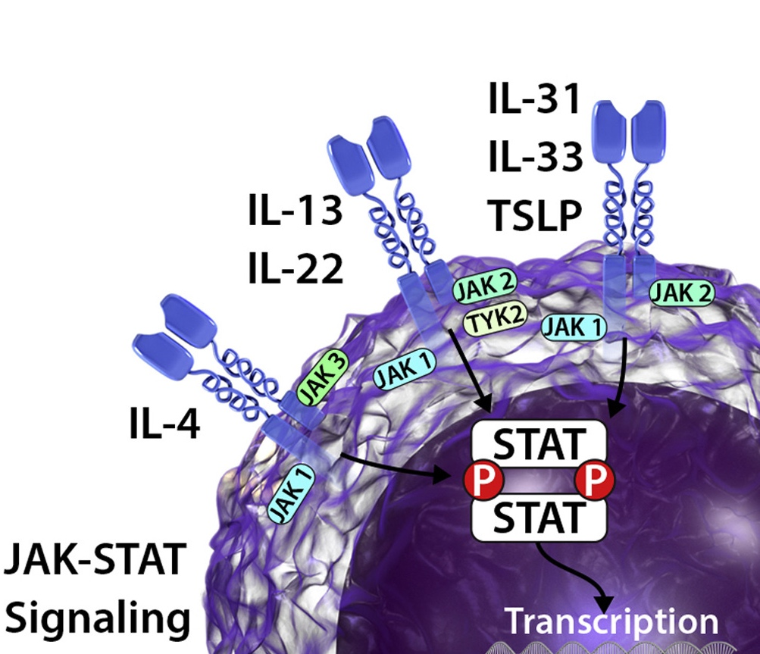
Figure 1
Annals of Allergy, Asthma & Immunology 2021 12621-31DOI: (10.1016/j.anai.2020.08.016)
Copyright © 2020 American College of Allergy, Asthma & Immunology Terms and Conditions
Notes:
Pathogenesis of atopic dermatitis: immune system targets. The epidermis is composed of both immune and nonimmune structural elements that provide a critical barrier for protection against allergens, pathogens, toxins, and irritants and for maintenance of skin hydration. Atopic dermatitis results from dysregulation of these components. Disrupted epidermal barrier function, resulting in increased susceptibility to external insults and increased transepidermal water loss, and immune dysregulation in both the innate and adaptive immune systems (eg, antimicrobial peptides, cytokines, lymphocytes, and other immune cells) contribute to a chronic inflammatory response. Antigen-presenting cells (Langerhans cells, inflammatory dendritic epidermal cells, dermal dendritic cells) and keratinocytes orchestrate the early stages of inflammation upon encountering allergens and other exogenous and endogenous signals. Keratinocyte-produced IL-25, IL-33, IL-36 and TSLP respond to environmental stimuli, including S aureus bacteria, to drive the production of proinflammatory mediators. The resulting type 2 inflammatory response is dominated by TH2 cell activity and group 2 innate lymphoid cells. Cytokines, particularly IL-13, and IL-4 contribute to barrier dysfunction, altered antimicrobial responses, B-cell IgE class switching, and eosinophil recruitment. Cytokine IL-31 is a key mediator of itch, driven by its binding to IL-31 receptors on itch sensory neurons of the dorsal root ganglion and potentiated by IL-4 and IL-13. Increases in IL-22 (produced mainly by TH22 cells) drive keratinocyte hyperproliferation, whereas increases in TH17 and TH1 cell activities are highly variable, based on age and race/ethnicity. The green print highlights targets of novel and emerging therapies. AMP, antimicrobial peptide; IFN, interferon; Ig, immunoglobulin; IL, interleukin; JAK, Janus kinase; PDE4, phosphodiesterase 4; STAT, signal transducer and activator of transcription; TH, T-helper cells; TSLP, thymic stromal lymphopoietin.

Slide 8
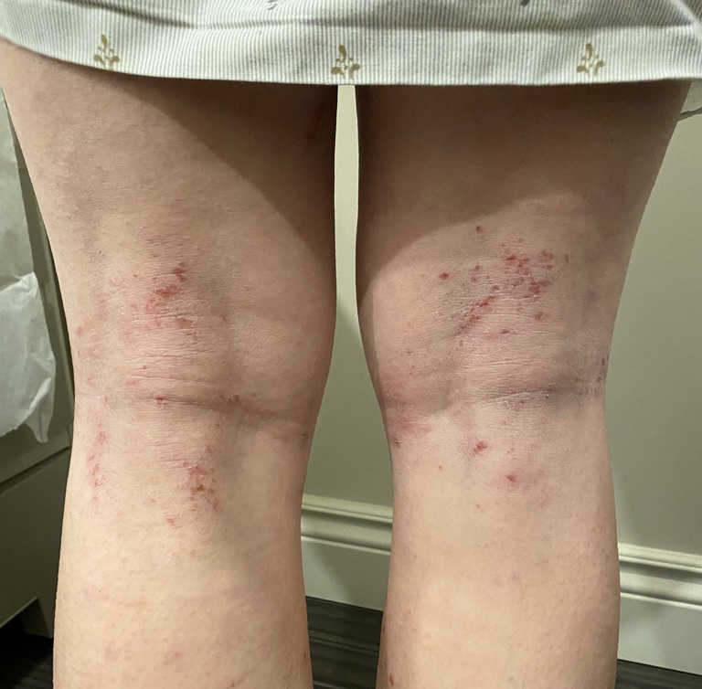
Figure 1
IL-13
IL-4
Modified from:
Annals of Allergy, Asthma & Immunology 2021 12621-31DOI: (10.1016/j.anai.2020.08.016)
Copyright © 2020 American College of Allergy, Asthma & Immunology Terms and Conditions: Photo courtesy of M. Gooderham
Notes:
Pathogenesis of atopic dermatitis: immune system targets. The epidermis is composed of both immune and nonimmune structural elements that provide a critical barrier for protection against allergens, pathogens, toxins, and irritants and for maintenance of skin hydration. Atopic dermatitis results from dysregulation of these components. Disrupted epidermal barrier function, resulting in increased susceptibility to external insults and increased transepidermal water loss, and immune dysregulation in both the innate and adaptive immune systems (eg, antimicrobial peptides, cytokines, lymphocytes, and other immune cells) contribute to a chronic inflammatory response. Antigen-presenting cells (Langerhans cells, inflammatory dendritic epidermal cells, dermal dendritic cells) and keratinocytes orchestrate the early stages of inflammation upon encountering allergens and other exogenous and endogenous signals. Keratinocyte-produced IL-25, IL-33, IL-36 and TSLP respond to environmental stimuli, including S aureus bacteria, to drive the production of proinflammatory mediators. The resulting type 2 inflammatory response is dominated by TH2 cell activity and group 2 innate lymphoid cells. Cytokines, particularly IL-13, and IL-4 contribute to barrier dysfunction, altered antimicrobial responses, B-cell IgE class switching, and eosinophil recruitment. Cytokine IL-31 is a key mediator of itch, driven by its binding to IL-31 receptors on itch sensory neurons of the dorsal root ganglion and potentiated by IL-4 and IL-13. Increases in IL-22 (produced mainly by TH22 cells) drive keratinocyte hyperproliferation, whereas increases in TH17 and TH1 cell activities are highly variable, based on age and race/ethnicity. The green print highlights targets of novel and emerging therapies. AMP, antimicrobial peptide; IFN, interferon; Ig, immunoglobulin; IL, interleukin; JAK, Janus kinase; PDE4, phosphodiesterase 4; STAT, signal transducer and activator of transcription; TH, T-helper cells; TSLP, thymic stromal lymphopoietin.

Slide 9
Figure 1
Dupilumab
Modified from:
Annals of Allergy, Asthma & Immunology 2021 12621-31DOI: (10.1016/j.anai.2020.08.016)
Copyright © 2020 American College of Allergy, Asthma & Immunology Terms and Conditions
Notes:
Pathogenesis of atopic dermatitis: immune system targets. The epidermis is composed of both immune and nonimmune structural elements that provide a critical barrier for protection against allergens, pathogens, toxins, and irritants and for maintenance of skin hydration. Atopic dermatitis results from dysregulation of these components. Disrupted epidermal barrier function, resulting in increased susceptibility to external insults and increased transepidermal water loss, and immune dysregulation in both the innate and adaptive immune systems (eg, antimicrobial peptides, cytokines, lymphocytes, and other immune cells) contribute to a chronic inflammatory response. Antigen-presenting cells (Langerhans cells, inflammatory dendritic epidermal cells, dermal dendritic cells) and keratinocytes orchestrate the early stages of inflammation upon encountering allergens and other exogenous and endogenous signals. Keratinocyte-produced IL-25, IL-33, IL-36 and TSLP respond to environmental stimuli, including S aureus bacteria, to drive the production of proinflammatory mediators. The resulting type 2 inflammatory response is dominated by TH2 cell activity and group 2 innate lymphoid cells. Cytokines, particularly IL-13, and IL-4 contribute to barrier dysfunction, altered antimicrobial responses, B-cell IgE class switching, and eosinophil recruitment. Cytokine IL-31 is a key mediator of itch, driven by its binding to IL-31 receptors on itch sensory neurons of the dorsal root ganglion and potentiated by IL-4 and IL-13. Increases in IL-22 (produced mainly by TH22 cells) drive keratinocyte hyperproliferation, whereas increases in TH17 and TH1 cell activities are highly variable, based on age and race/ethnicity. The green print highlights targets of novel and emerging therapies. AMP, antimicrobial peptide; IFN, interferon; Ig, immunoglobulin; IL, interleukin; JAK, Janus kinase; PDE4, phosphodiesterase 4; STAT, signal transducer and activator of transcription; TH, T-helper cells; TSLP, thymic stromal lymphopoietin.

Slide 10
Figure 1
Tralokinumab
Lebrikizumab
Modified from:
Annals of Allergy, Asthma & Immunology 2021 12621-31DOI: (10.1016/j.anai.2020.08.016)
Copyright © 2020 American College of Allergy, Asthma & Immunology Terms and Conditions
Notes:
Pathogenesis of atopic dermatitis: immune system targets. The epidermis is composed of both immune and nonimmune structural elements that provide a critical barrier for protection against allergens, pathogens, toxins, and irritants and for maintenance of skin hydration. Atopic dermatitis results from dysregulation of these components. Disrupted epidermal barrier function, resulting in increased susceptibility to external insults and increased transepidermal water loss, and immune dysregulation in both the innate and adaptive immune systems (eg, antimicrobial peptides, cytokines, lymphocytes, and other immune cells) contribute to a chronic inflammatory response. Antigen-presenting cells (Langerhans cells, inflammatory dendritic epidermal cells, dermal dendritic cells) and keratinocytes orchestrate the early stages of inflammation upon encountering allergens and other exogenous and endogenous signals. Keratinocyte-produced IL-25, IL-33, IL-36 and TSLP respond to environmental stimuli, including S aureus bacteria, to drive the production of proinflammatory mediators. The resulting type 2 inflammatory response is dominated by TH2 cell activity and group 2 innate lymphoid cells. Cytokines, particularly IL-13, and IL-4 contribute to barrier dysfunction, altered antimicrobial responses, B-cell IgE class switching, and eosinophil recruitment. Cytokine IL-31 is a key mediator of itch, driven by its binding to IL-31 receptors on itch sensory neurons of the dorsal root ganglion and potentiated by IL-4 and IL-13. Increases in IL-22 (produced mainly by TH22 cells) drive keratinocyte hyperproliferation, whereas increases in TH17 and TH1 cell activities are highly variable, based on age and race/ethnicity. The green print highlights targets of novel and emerging therapies. AMP, antimicrobial peptide; IFN, interferon; Ig, immunoglobulin; IL, interleukin; JAK, Janus kinase; PDE4, phosphodiesterase 4; STAT, signal transducer and activator of transcription; TH, T-helper cells; TSLP, thymic stromal lymphopoietin.

Slide 11
Figure 1
JAK 1 inhibitors
Modified from:
Annals of Allergy, Asthma & Immunology 2021 12621-31DOI: (10.1016/j.anai.2020.08.016)
Copyright © 2020 American College of Allergy, Asthma & Immunology Terms and Conditions
Notes:
Pathogenesis of atopic dermatitis: immune system targets. The epidermis is composed of both immune and nonimmune structural elements that provide a critical barrier for protection against allergens, pathogens, toxins, and irritants and for maintenance of skin hydration. Atopic dermatitis results from dysregulation of these components. Disrupted epidermal barrier function, resulting in increased susceptibility to external insults and increased transepidermal water loss, and immune dysregulation in both the innate and adaptive immune systems (eg, antimicrobial peptides, cytokines, lymphocytes, and other immune cells) contribute to a chronic inflammatory response. Antigen-presenting cells (Langerhans cells, inflammatory dendritic epidermal cells, dermal dendritic cells) and keratinocytes orchestrate the early stages of inflammation upon encountering allergens and other exogenous and endogenous signals. Keratinocyte-produced IL-25, IL-33, IL-36 and TSLP respond to environmental stimuli, including S aureus bacteria, to drive the production of proinflammatory mediators. The resulting type 2 inflammatory response is dominated by TH2 cell activity and group 2 innate lymphoid cells. Cytokines, particularly IL-13, and IL-4 contribute to barrier dysfunction, altered antimicrobial responses, B-cell IgE class switching, and eosinophil recruitment. Cytokine IL-31 is a key mediator of itch, driven by its binding to IL-31 receptors on itch sensory neurons of the dorsal root ganglion and potentiated by IL-4 and IL-13. Increases in IL-22 (produced mainly by TH22 cells) drive keratinocyte hyperproliferation, whereas increases in TH17 and TH1 cell activities are highly variable, based on age and race/ethnicity. The green print highlights targets of novel and emerging therapies. AMP, antimicrobial peptide; IFN, interferon; Ig, immunoglobulin; IL, interleukin; JAK, Janus kinase; PDE4, phosphodiesterase 4; STAT, signal transducer and activator of transcription; TH, T-helper cells; TSLP, thymic stromal lymphopoietin.

Slide 12
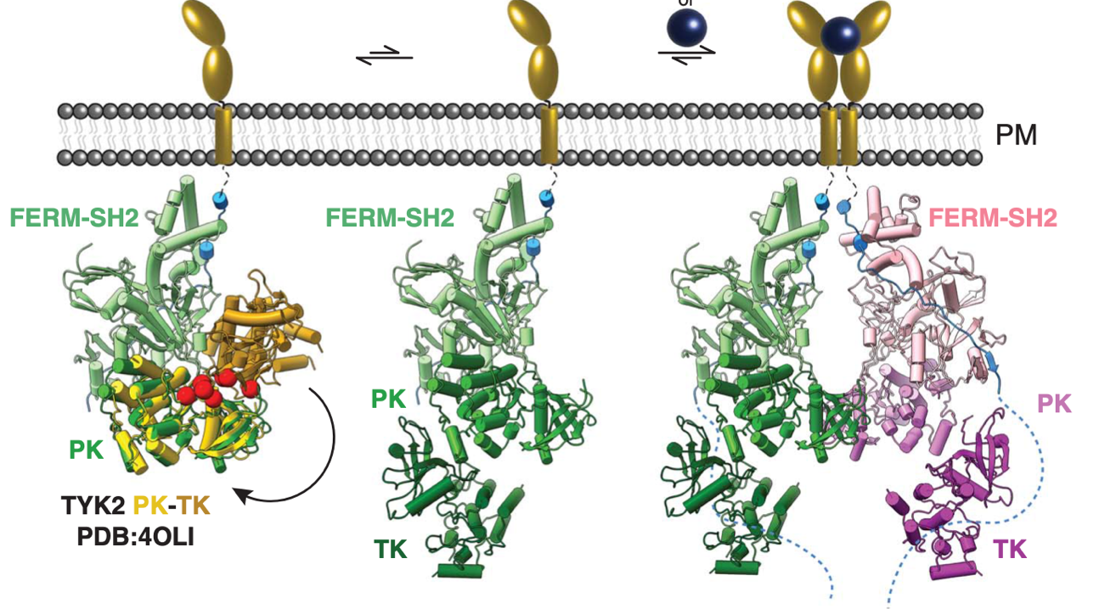
JAK signaling
Autoinhibited “closed” state of intracellular JAK
Partially active “open” state of intracellular JAK exposing PK domain
Cytokine-mediated receptor dimerization liberating the kinase domains for phosphotransferase activity
Glassman, C. R. et al. Science 2022, 376 (6589), 163–169. https://doi.org/10.1126/science.abn8933.

Slide 13
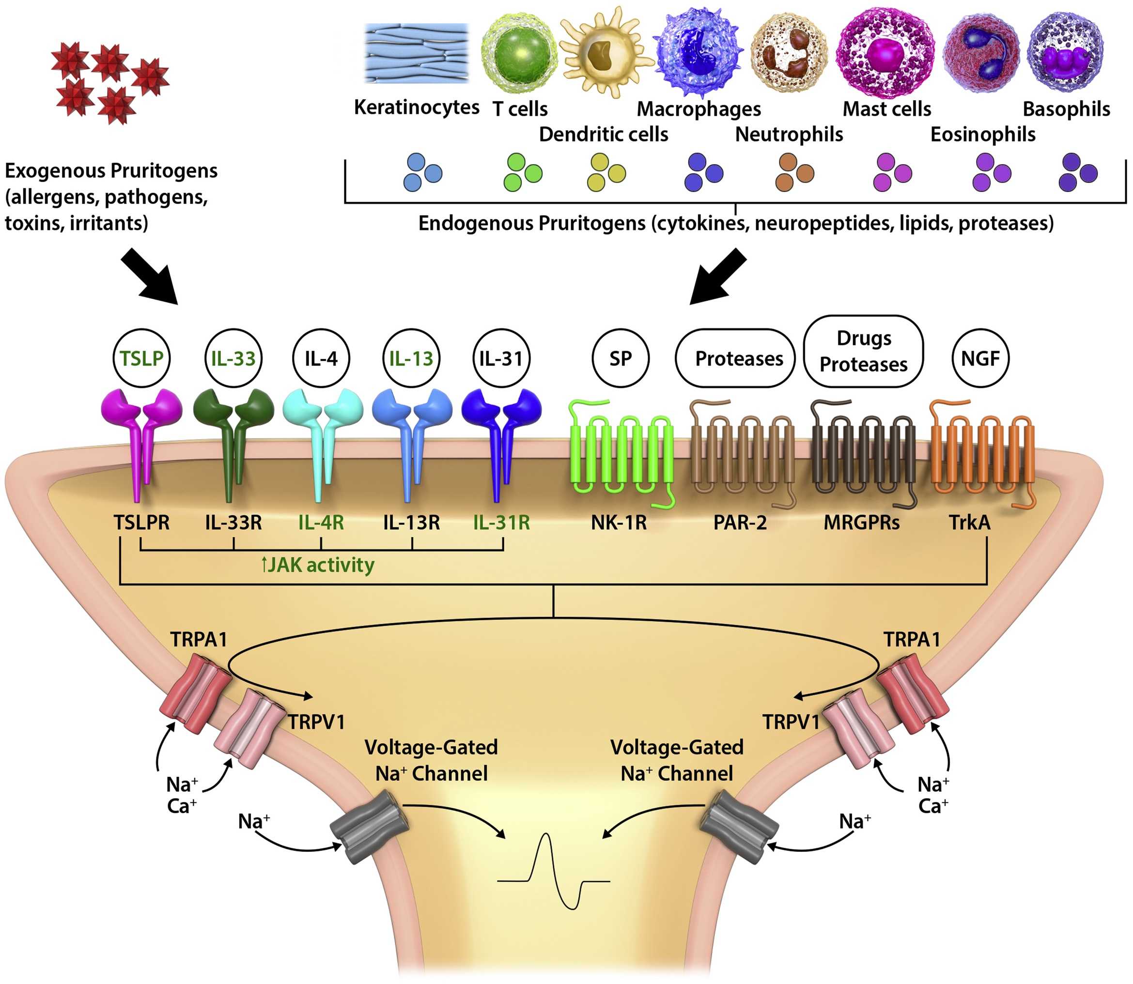
Figure 2
Itch!
Annals of Allergy, Asthma & Immunology 2021 12621-31DOI: (10.1016/j.anai.2020.08.016)
Copyright © 2020 American College of Allergy, Asthma & Immunology Terms and Conditions
Notes:
Cutaneous itch sensation in atopic dermatitis: a new focus for finding new targets. Exogenous pruritogens (eg, allergens, pathogens, toxins, and other irritants, such as proteases) from the external environment and endogenous pruritogens (eg, cytokines, neuropeptides, signaling lipids, and proteases) released from keratinocytes and immune cells bind to various receptors on cutaneous itch sensory neurons. Comprised mostly of unmyelinated C-fibers, these sensory neurons signal the itch sensation (as action potentials) to specific dorsal root ganglia and then the central nervous system. Nonhistaminergic, itch-sensitive C-fibers are most important for the itch sensation in atopic dermatitis and are activated by pruritogens, including cytokines (IL-4, IL-13, IL-31, IL-33, TSLP), SP, proteases, circulating drugs, and neurotrophic factors (eg, NGF). Binding of a mediator to its respective receptor results in a secondary messenger signaling cascade, which activates the TRP family of cation channels (especially TRPA and TRPV) and ultimately leads to activation of voltage-gated sodium channels and neuronal depolarization. The TRP channels can also be directly activated by a variety of exogenous and endogenous stimuli (eg, noxious chemicals, temperature, extracellular pH, reactive oxygen species, eicosanoids). Activated C-fibers themselves produce local inflammatory mediators, including SP and calcitonin gene–related peptide. The green print highlights targets of novel and emerging therapies. Ca⁺, calcium ion; IL, interleukin; JAK, Janus kinase; Na⁺, sodium ion; NGF, nerve growth factor; NK, natural killer; PAR-2, protease activated receptor 2; R, receptor; SP, substance P; TRP, transient receptor potential; TrkA, tropomyosin receptor kinase A; TRPV1, transient receptor potential cation channel subfamily V member 1; TSLP, thymic stromal lymphopoietin.

Slide 14
Available and emerging therapies for AD
Conventional systemic drugs Risk of side effects
and organ damage
Biologics: Target cytokines & receptors
Safer, higher efficacy
Small molecule targeted therapies: Target signaling of various cytokines
Safer, more effective
Cyclosporine*
IL-4,13 inhibitor (IL-4Rα) (dupilumab)
JAK 1 inhibitors (abrocitinib, upadacitinib)
Methotrexate*
IL-13 inhibitors (tralokinumab, lebrikizumab)
Azathioprine*
Mycophenolate*
Prednisone
* OFF LABEL USE

Slide 15
NMA: Comparison of Targeted Therapies without TCS for Mod-to-Severe AD
EASI 75
EASI 90
Response Rate (%)
Notes:
Speaker guidance:
This network meta-analysis (NMA) compared efficacy measures of skin clearance and itch among targeted therapies for moderate-to-severe AD when used as monotherapy without concomitant topical corticosteroids (TCS).
The NMA analyzed 11 unique phase 3, placebo-controlled trials encompassing 6,254 patients in 28 arms across five targeted therapies (abrocitinib, baricitinib, dupilumab, tralokinumab, upadacitinib).
As can be seen in the figure, EASI-75 and -90 response rates were greatest for upadacitinib 30 mg, followed by abrocitinib 200 mg, upadacitinib 15 mg, and dupilumab 300 mg.
Reference:
Silverberg JI, Hong HC, Thyssen JP, et al. Comparison of Efficacy of Targeted Therapies without Topical Corticosteroids for Moderate to Severe Atopic Dermatitis: Systematic Review and Network Meta-analysis. Presented at the Revolutionizing Atopic Dermatitis (RAD), Virtual Meeting, June 13, 2021

Slide 16
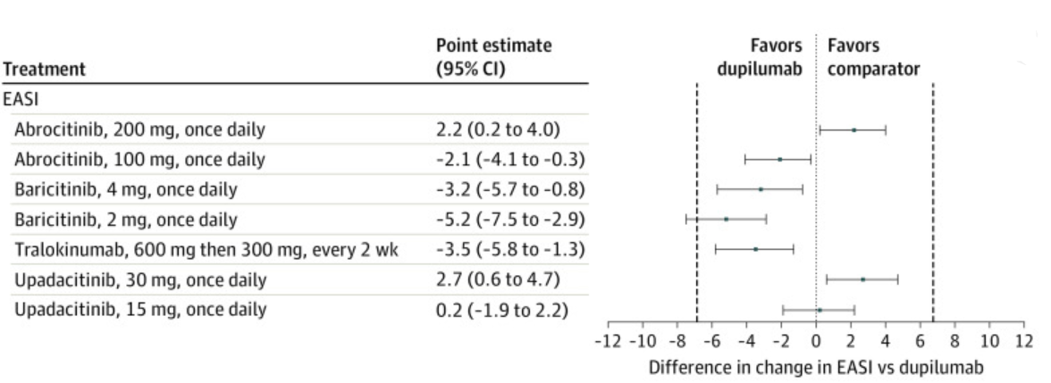
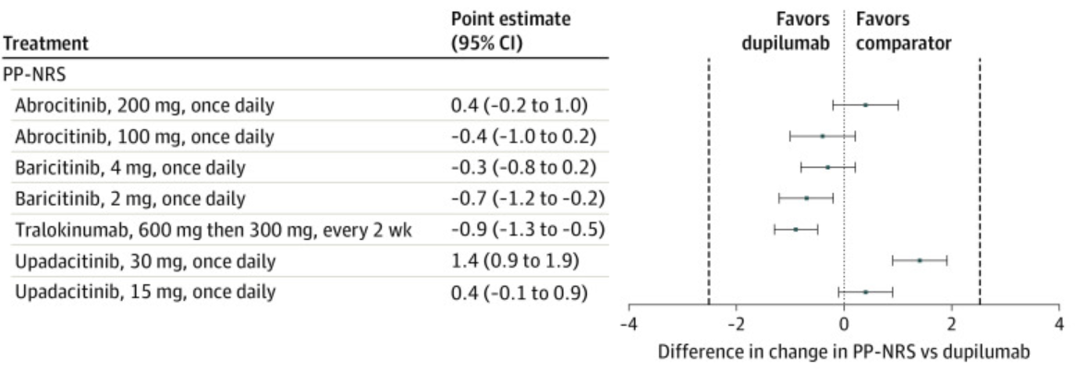
NMA Results of Adults Treated Between 8 & 16 Wks (Change in EASI & PP-NRS)
EASI
PP-NRS
NMA – consider potential differences between the populations, treatments and outcomes.
NMA are not substitutes for multiple head-to-head RCT comparisons
Drucker A, et al. JAMA Dermatol. 2022 May; 158(5): 523–532.
Notes:
Forest plots showing change in Eczema Area and Severity Index (EASI), and Peak Pruritus Numeric Rating Scales (PP-NRS). Results are presented for medications currently used in clinical practice or likely to be approved soon vs dupilumab on-label dosing (600 mg then 300 mg every 2 weeks). Results are presented as mean difference (MD) with 95% credible intervals (CrI). Positive values represent improvement in the disease state vs dupilumab. The vertical dashed lines represent the minimal clinically important difference for each scale. Authors can be contacted for relative effect estimates for all pairwise comparisons in the networks.

Slide 17
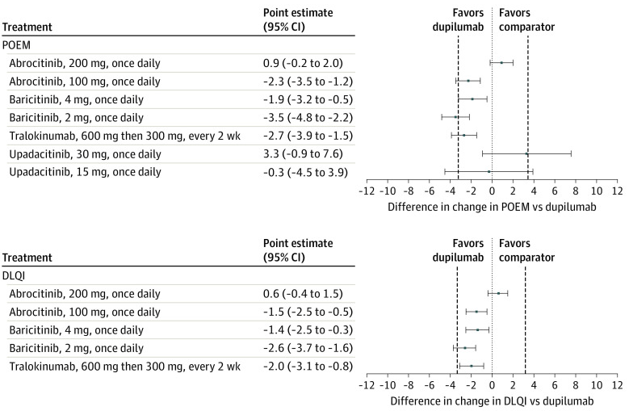
NMA Results of Adults Treated Between 8 & 16 Wks (Change in POEM & DLQI)
POEM
DLQI
NMA – consider potential differences between the populations, treatments and outcomes.
NMA are not substitutes for multiple head-to-head RCT comparisons
Drucker A, et al. JAMA Dermatol. 2022 May; 158(5): 523–532.
Notes:
Forest plots showing change in Patient Oriented Eczema Measure (POEM) and Dermatology Life Quality Index (DLQI). Results are presented for medications currently used in clinical practice or likely to be approved soon vs dupilumab on-label dosing (600 mg then 300 mg every 2 weeks). Results are presented as mean difference (MD) with 95% credible intervals (CrI). Positive values represent improvement in the disease state vs dupilumab. The vertical dashed lines represent the minimal clinically important difference for each scale. Authors can be contacted for relative effect estimates for all pairwise comparisons in the networks.

Slide 18
Short-term effectiveness of biologics & small molecules: systematic review & NMA
Monotherapy
Trials
EASI 75 rates with monotherapy
SAE risk with monotherapy
Drugs vs PBO
Drugs vs PBO
Treatment
(EASI 75)
OR
95% CI
Treatment
(ONE SAE)
OR
95% CI
PBO
1.00
BARI4
0.08
[0.02; 0.26]
NEMO60Q4W
1.58
[0.78; 3.21]
BARI2
0.23
[0.07; 0.79]
BARI2
2.76
[1.73; 4.40]
DUPI300Q2W
0.45
[0.23; 0.89]
TRALO300Q2W
2.95
[2.13; 4.09]
UPA15
0.50
[0.23; 1.11]
BARI4
3.67
[2.35; 5.75]
UPA30
0.96
[0.46; 1.99]
ABRO100
5.14
[3.21; 8.23]
PBO
1.00
LEBRI250Q2W
5.65
[2.35; 13.60]
ABRO100
1.01
[0.31; 3.32]
DUPI300Q2W
6.25
[4.60; 8.51]
LEBRI250Q2W
1.01
[0.14; 7.27]
UPA15
10.89
[8.13; 14.59]
TRALO300Q2W
1.26
[0.65; 2.43]
ABRO200
11.26
[7.02; 18.05]
ABRO200
1.43
[0.41; 4.97]
UPA30
18.90
[13.94; 25.62]
NEMO60Q4W
1.48
[0.24; 9.02]
0.1
0.5
0.1
0.5
1
2
10
1
2
10
Favors placebo
Favors treatment
Favors treatment
Favors placebo
ABRO100, abrocitinib 100 mg daily; ABRO200, abrocitinib 200 mg daily; AD, atopic dermatitis; BARI2, baricitinib 2 mg daily; BARI4, baricitinib 4 mg daily; CI, confidence interval; DUPI300Q2W, dupilumab 300 mg every other week; EASI 75, ≥75% improvement in Eczema Area and Severity Index; LEBRI250Q2W, lebrikizumab 250 mg every other week; NEMO60Q4W, nemolizumab 60 mg every 4 weeks; OR, odds ratio; PBO, placebo; RCT, randomized controlled trial; TCS, topical corticosteroids; TEZE280Q2W, tezepalumab 280 mg every other week; TRALO300Q2W, tralokinumab 300 mg every other week; UPA15, upadacitinib 15 mg daily; UPA30, upadacitinib 30 mg daily
NMA – consider potential differences between the populations, treatments and outcomes.
NMA are not substitutes for multiple head-to-head RCT comparisons
Pereyra-Rodriguez JJ, et al. Life (Basel) 2021;11:927
Notes:
23 RCTs in adults were included in the quantitative analysis (14 including 3582 patients in monotherapy and 9 including 3686 patients with TCS). The evaluation period was the primary efficacy endpoint timeframe for the molecules (12 weeks for abrocitinib; 16 weeks for all others)
Number of patients experiencing at least one SAE were assessed during the primary endpoint timeframe (12 weeks for abrocitinib; 16 weeks for all others)

Slide 19
Short-term effectiveness of biologics & small molecules: systematic review & NMA
Combination
Therapy
EASI 75 rates in combination with TCS
SAE risk in combination with TCS
Drugs vs PBO
Drugs vs PBO
Treatment
(EASI 75)
OR
95% CI
Treatment
(ONE SAE)
OR
95% CI
PBOTCS
1.00
TRALO300Q2WTCS
0.26
[0.06; 1.17]
TEZE280Q2WTCS
1.27
[0.51; 3.13]
ABRO200TCS
0.32
[0.06; 1.60]
BARI2TCS
2.12
[1.43; 3.13]
TRALO300Q2WTCS
2.29
[1.47; 3.55]
UPA30TCS
0.45
[0.14; 1.46]
BARI4TCS
2.55
[1.70; 3.82]
BARI2TCS
0.53
[0.16; 1.80]
ABRO100TCS
3.87
[2.63; 5.70]
TEZE280Q2WTCS
0.67
[0.11; 4.15]
DUPI300Q2WTCS
5.10
[3.83; 6.80]
DUPI300Q2WTCS
0.71
[0.28; 1.83]
UPA15TCS
5.20
[3.67; 7.37]
UPA15TCS
0.78
[0.29; 2.12]
ABRO200TCS
6.12
[4.08; 9.19]
ABRO100TCS
0.93
[0.30; 2.91]
UPA30TCS
9.43
[6.50; 13.68]
PBOTCS
1.00
BARI4TCS
1.65
[0.57; 4.75]
0.1
0.5
1
2
10
0.1
0.5
1
2
10
Favors placebo
Favors treatment
Favors treatment
Favors placebo
ABRO100, abrocitinib 100 mg daily; ABRO200, abrocitinib 200 mg daily; AD, atopic dermatitis; BARI2, baricitinib 2 mg daily; BARI4, baricitinib 4 mg daily; CI, confidence interval; DUPI300Q2W, dupilumab 300 mg every other week; EASI 75, ≥75% improvement in Eczema Area and Severity Index; LEBRI250Q2W, lebrikizumab 250 mg every other week; NEMO60Q4W, nemolizumab 60 mg every 4 weeks; OR, odds ratio; PBO, placebo; RCT, randomized controlled trial; TCS, topical corticosteroids; TEZE280Q2W, tezepalumab 280 mg every other week; TRALO300Q2W, tralokinumab 300 mg every other week; UPA15, upadacitinib 15 mg daily; UPA30, upadacitinib 30 mg daily
NMA – consider potential differences between the populations, treatments and outcomes.
NMA are not substitutes for multiple head-to-head RCT comparisons
Pereyra-Rodriguez JJ, et al. Life (Basel) 2021;11:927
Notes:
23 RCTs in adults were included in the quantitative analysis (14 including 3582 patients in monotherapy and 9 including 3686 patients with TCS). The evaluation period was the primary efficacy endpoint timeframe for the molecules (12 weeks for abrocitinib; 16 weeks for all others)
Number of patients experiencing at least one SAE were assessed during the primary endpoint timeframe (12 weeks for abrocitinib; 16 weeks for all others)

Slide 20
Safety with Monoclonal antibodies
Dupilumab, tralokinumab, lebrikizumab
Similar safety profiles between agents
No laboratory parameter changes
No drug-drug interactions
Ocular Surface
Disease
(conjunctivitis)
Head and neck erythema
Injection site reaction

Slide 21
Safety with JAK inhibitors
Most AE data comes from RA, IBD and myelofibrosis.
Newer data from PsA, AD
Laboratory
changes
Infection
Safety
Concerns
Cytopenias
Contraindicated in pregnancy
Thrombosis
Malignancy
Tolerability issues arise with some agents: nausea, vomiting, headache and acne have been reported
MACE

Slide 22
Laboratory parameters
Lipids
dose-dependent and reversible elevation of total, LDL and HDL cholesterol with most JAK inhibitors
Creatinine kinase (CK)
Elevations reported in most trials, usually after exercise
Has not been associated with rhabdomyolysis in most cases
Cytopenias
Neutropenia, lymphopenia and thrombocytopenia all reported
Rinvoq product monograph, Olumiant product monograph, Xeljanz product monograph, Cibinqo product monograph

Slide 23
Malignancy
ORAL Surveillance
Study A3921133 (ClinicalTrials.gov NCT02092467)
TOFA 5mg BID, 10 mg BID, ETN, ADA in RA
Patients >50y, >1 cardiac risk factor
Blinded end-point of malignancy and MACE
Cases of lymphoma in the RA trials
Lymphoma and other malignancies noted in boxed warning
ORAL SURVEILLANCE
During a median follow-up of 4.0 years, the incidence cancer was higher with the combined tofacitinib doses (4.2% [122 patients]) than with a TNF inhibitor (2.9% [42 patients])
Hazard ratio of 1.48 (95% CI, 1.04 to 2.09) for cancer
Rinvoq product monograph, Olumiant product monograph, Xeljanz product monograph; Mease P, Charles- Schoeman C, Cohen S, et al. Ann Rheum Dis 2020;79:1400–1413. Ytterberg et al. New England Journal of Medicine 386, 316–326

Slide 24
Infections
Serious Infections
Rates of serious infection with JAKi are low, but have been reported, some fatal, most with concomitant MTX or steroids
TB is a concern, and should be screened and treated with prophylaxis, similar to TNFi
Herpes infections
JAKi, across studies in RA, psoriasis, AD and UC, are associated with a dose dependent increased incidence of herpes zoster and herpes simplex infection
Rinvoq product monograph, Olumiant product monograph, Xeljanz product monograph

Slide 25
Venous Thrombosis and MACE
Venous Thromboembolic events (VTE)
DVT and PE were noted in RA patients in JAK trials
Recent meta-analyses of multiple studies do not support the warning, with rates similar to placebo and population rates
Real world reporting also did not support
ORAL surveillance study (MACE)
Incidence of MACE higher with the combined tofacitinib doses (3.4% [98 patients] than with a TNF inhibitor (2.5% [37 patients]
Hazard ratios were 1.33 (95% CI, 0.91 to1.94) for MACE
Rinvoq product monograph, Olumiant product monograph, Xeljanz product monograph; Ytterberg et al. New England Journal of Medicine 386, 316–326

Slide 26
How to use JAK inhibitors:
Baseline work up:
Baseline bloodwork: CBC, liver transaminases, lipid profile
TB test or quantiferon gold
Check Hepatitis B viral status
Consider Herpes Zoster vaccination (non-live)
AVOID:
Use in women planning pregnancy or lactation
Live vaccines
CAUTION:
Patients with comorbidities or risk factors for VTE and MACE
history of VTE, hypercoagulable state, smoking, immobilisation, recent trauma or surgery, cardiovascular disease, cancer, obesity, frequent long flights, and hormonal therapy
Patients >50 years old
Patients with history of serious infections
Don’t forget:
HZ vaccination
Shingrix
Advise on contraception
Use lowest dose of JAKi necessary
MONITOR:
CBC and transaminases at 4 weeks, then standard of care
Lipids at 8-12 weeks, then standard of care
Monitor for signs of infection, VTE
Age-appropriate malignancy screening
Adapted from Agrawal et al. Journal of Crohn's and Colitis, 2020, S755–S760; Rinvoq PM, Cibinqo PM, and personal opinion

Slide 27
Take home messages
Patients who are not adequately controlled on topical therapy are candidates for systemic therapy
Blocking key inflammatory signals in AD - either outside the cell with monoclonal antibodies, or inside the cell with small molecules – can control this dysregulated immune response
High levels of efficacy and promising safety profiles provide improved quality of life for patients with AD

Slide 28
Thank you!

