Slide 1
A-Topics: Topic 5
Novel Systemic Therapies for the Treatment of Atopic Dermatitis
Scientific Panel Lecturer: Dr. Melinda Gooderham Community panelist : Dr. Lisa Iannattone Affiliations: Assistant Professor, McGill University

Slide 2
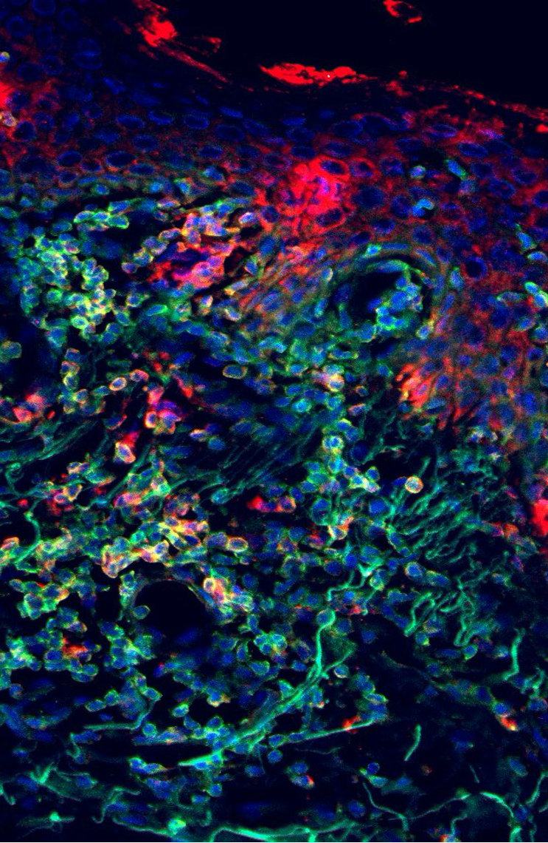
Disclosures
Lisa Iannattone
Relationships with for-profit and/or non-profit organizations:
Grant/Research Support: nil
Speakers Bureau/Honoraria: Sun Pharma, Sanofi, UCB Canada, Galderma, RBC Consultants
Other: Canadian Dermatology Association (Board of Directors)

Slide 3
Key points for: Dermatology Trainees
Novel systemic therapies target the molecular signalling pathways that cause AD
IL-4 and IL-13 bind to their receptors and activate the JAK-STAT pathway which results in the development of atopic dermatitis
The new systemic AD therapeutics target these cytokines, receptors or downstream signaling pathways to control the symptoms of AD
Dupilumab targets the IL-4R alpha subunit common to the IL-4 and IL-13 receptors, Tralokinumab/Lebrikizumab bind IL-13 cytokine and JAK-1 inhibitors abrocitinib/upadacitinib inhibit the downstream cytokine signals
Several novel systemic therapies for AD are highly effective
When comparing improvement in EASI score, upadacitinib 30mg and abrocitinib 200mg are the most effective systemic agents, followed by dupilumab.
70%, 62% and 43% of patients respectively achieved 75% improvement (EASI 75) in the trials.
In a meta-analysis comparing new agents to Dupilumab, no differences were seen for POEMS or DLQI.
Monoclonal antibodies have a more favorable adverse event profile than JAK-1 inhibitors
AE of monoclonal antibodies include conjunctivitis, head and neck erythema and injection site reactions. No lab monitoring is required.
AE of JAK-1 inhibitors include tolerability issues secondary to nausea, vomiting, headache and acne, as well as cytopenias, CK elevations, dyslipidemia, MACE, thrombosis, malignancy, herpesvirus reactivation. Monitoring is required.
Safety data for the JAK-1 inhibitors was generated from several different patient populations. There was no statistically significant difference in serious adverse events compared to placebo for any of the systemic agents in the atopic dermatitis trials.

Slide 4
Key points for: General Practicioners
Novel systemic therapies target the molecular signalling pathways that cause AD
Patients that are not adequately controlled on topical therapies are candidates for systemic therapy.
IL-4 and IL-13 cytokines bind to their receptors and activate the JAK-STAT pathway which results in the development of atopic dermatitis
The new systemic AD therapeutics include monoclonal antibodies (dupilumab, tralokinumab, lebrikizumab) that target the IL-4/IL-13 cytokines or receptors and JAK-1 inhibitors (upadacitinib, abrocitinib) that target the downstream JAK-STAT signaling pathway.
Several novel systemic therapies for AD are highly effective
When comparing improvement in EASI score, upadacitinib 30mg and abrocitinib 200mg are the most effective systemic agents, followed by dupilumab.
70%, 62% and 43% of patients respectively achieved 75% improvement (EASI 75) in the trials.
In a meta-analysis comparing new agents to dupilumab, no differences were seen for scores that measure the patient experience of their eczema (POEMS) or quality of life (DLQI).
Monoclonal antibodies have a more favorable adverse event profile than JAK-1 inhibitors
AE of monoclonal antibodies include conjunctivitis, head and neck erythema and injection site reactions. No lab monitoring is required.
AE of JAK-1 inhibitors include tolerability issues secondary to nausea, vomiting, headache and acne, as well as cytopenias, CK elevations, dyslipidemia, MACE, thrombosis, malignancy, and herpesvirus reactivation. Monitoring is required.
Safety data for the JAK-1 inhibitors was generated from several different patient populations. There was no statistically significant difference in serious adverse events compared to placebo for any of the systemic agents in the atopic dermatitis trials.

Slide 5
Key points for: Adult-Adolescent Patients
Novel systemic therapies target the molecular signalling pathways that cause AD
Patients that are not adequately controlled on topical therapies are candidates for systemic therapy.
IL-4 and IL-13 cytokines bind to their receptors and activate the JAK-STAT pathway which results in the development of atopic dermatitis
The new systemic AD therapeutics include monoclonal antibodies (dupilumab, tralokinumab, lebrikizumab) that target the IL-4/IL-13 cytokines or receptors and JAK-1 inhibitors (upadacitinib, abrocitinib) that target the downstream JAK-STAT signaling pathway.
Several novel systemic therapies for AD are highly effective
When comparing improvement in EASI score, upadacitinib 30mg and abrocitinib 200mg are the most effective systemic agents, followed by dupilumab.
70%, 62% and 43% of patients respectively achieved 75% improvement (EASI 75) in the trials.
In a meta-analysis comparing new agents to dupilumab, no differences were seen for scores that measure the patient experience of their eczema (POEMS) or quality of life (DLQI).
Monoclonal antibodies have a more favorable adverse event profile than JAK-1 inhibitors
AE of monoclonal antibodies include conjunctivitis, head and neck erythema and injection site reactions. No lab monitoring is required. Approved for pediatric use.
AE of JAK-1 inhibitors include tolerability issues secondary to nausea, vomiting, headache and acne, as well as cytopenias, CK elevations, dyslipidemia, MACE, thrombosis, malignancy, and herpesvirus reactivation. Monitoring is required.
Safety data for the JAK-1 inhibitors was generated from several different patient populations. There was no statistically significant difference in serious adverse events compared to placebo for any of the systemic agents in the atopic dermatitis trials.

Slide 6
What added information is needed for… ?
Dermatology Trainees (e.g. for a fellowship curriculum)
Will patients still require topical therapies
How to determine treatment failure
How to switch from one agent to another
General practitioners (e.g. For an accredited course)
Discussion about the different routes of administration
Should patients expect to still need topical therapies once they’re on a systemic medication
How long should patients expect to be on the medication
Adult-adolescent patients (e.g. for an Eczema school)
Discussion about the different routes of administration
Should patients expect to still need topical therapies once they’re on a systemic medication
How long should patients expect to be on the medication

Slide 7
Three points most relevant to my practice?
Novel systemic agents for AD are highly effective, particularly JAK-1 inhibitors.
Novel systemic agents for AD have a favorable safety profile, particularly monoclonal antibodies.
Systemic agents should be used for patient that do not achieve adequate control on topical therapies.
Points relevant to my practice not found and/or irrelevant info?
Rates of SAE with JAK-1 inhibitors (MACE, clots, malignancy) for consent discussions.
What proportion of patients will still require topical therapy once they are on a novel systemic therapeutic.

Slide 8
Prepare 2-3 post-video questions for derm trainees (Multiple choice, true/false, and/or short-answer questions from topic)
Question 1: The IL-4R alpha subunit is the target for which of the following AD therapeutics?
A) Tralokinumab
B) Dupilumab
C) Abrocitinib
D) Upadacitinib
Question 2: Which of the following AD therapeutics achieved the highest EASI75 score in clinical trials?
A) Upadacitinib 15mg
B) Upadacitinib 30mg
C) Abrocitinib 200mg
D) Dupilumab

Slide 9
Key Takeaway: Vote via Annotation
Novel systemic therapies target the molecular signalling pathways that cause AD
Several novel systemic therapies for AD are highly effective
Monoclonal antibodies have a more favorable adverse event profile than JAK-1 inhibitors

