Slide 1
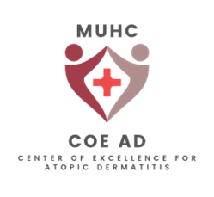
A-Topics: Topic 2
Translational aspects in pathobiology of AD: Targeting molecular Pathways)
Scientific Panelist: Professor Thomas Bieber, MD
Community panelist :Dr Catherine Besner Morin Affiliations: Dermatologist CHUM, Director Allergic and Occupation Contact Dermatitis Clinic
Assistant professor University of Montreal
Notes:
Voix de signalement qui sont ciblés

Slide 2
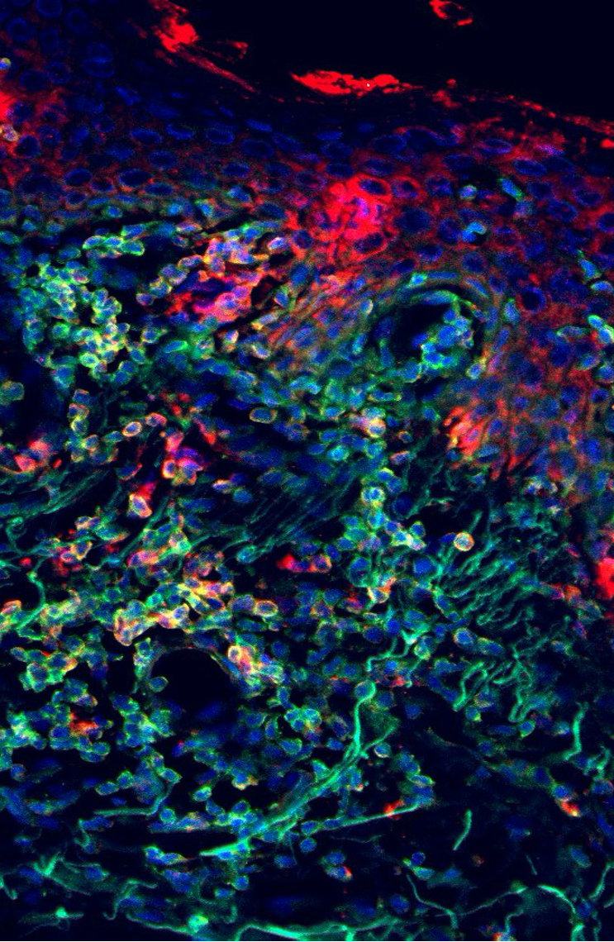
Disclosures
Dr Catherine Besner Morin
Relationships with for-profit and/or non-profit organizations:
Grant/Research Support: -University of Montreal (educational grant)
Speakers Bureau/Honoraria:
- Janssen
Sanofy
Vichy
Leo pharma
Sun pharmaceuticals
Johnson and Johnson
Galderma
Notes:
Projet educatif
Pas de lien

Slide 3
Key points for: Dermatology Trainees
At the beginning, activation of the innate system in the skin (PHASE 1)
Allergens ? Irritant? Environmental factors (tissue damage)
PHASE 2: adaptive immune response
Core TH2 →Ige sensitization to allergens
TH1,TH22,TH17
Atopic dermatitis has different phenotypes that correlate with different cytokines profiles depending on age and /or ethnic background…
Evolution of the immune dysregulation through time: TH2, Th22,TH17 in infant and as you get older TH1 also present not just Th2
African American only Th2 and TH22, Asian more TH22,17
Ige sensitization to SELF-proteins (worsen by itch/scratch cycle)→ autoimmune disease
IL-13 is the main cytokine in AD
Increase IL-31, inflammatory trafficking, mast cell activation, eosinophils recruitments, staph aureus colonization, ceramide and sphingomyelin content; decrease epidermal barrier proteins (FLG,LOR, IVL), keratinocyte differentiation; is pruritogenic
Dupilumab block IL-4$α$ receptor, preventing IL-13 and Il-4 signaling
Tralokinumab interacts with IL-13 itself
Jak 1,2,3, TYR2 are intracellular tyrosine kinase. They are important to many different cytokines and growth factors, leading to diverse roles, some welcome and physiological, some promoting AD
Jak-2 is related to many physiological function such as lymphoid and myeloid differentiation, haematopoiesis, growth, anabolic metabolism, lipid metabolism, bone resorption
Jak inhibitors are small enough that they can be used topically
Soon: Amlitelimab the first in class targeted therapy acting “upstream” of the inflammatory cascade
By blocking OX40L, inhibit the contact between antigen presenting cell and the effector t-cell (phase 1)
Could stop inflammation at a very early stage .
Early treatments with new targeted treatment may stop
Atopic march (AR, asthma, food allergy)
Stop the progression of the disease (mild-severe)
Prevent AD altogether in a genetically prone individual
Notes:
1- pierre angulaire, profile cytokinien, habileter patient
IVL = involucrin
Iiné systeme immunitaire dadapté
Hapten

Slide 4
Key points for: General Practitioners
Atopic dermatitis is a genetic disease where
Skin barrier defect : let irritants, allergens and pathogens
Increase water loss
Immune dysregulation : chronic inflammation
Abnormal microbiome : increased staphylococcus aureus
Atopic dermatitis is a T-helper cell -2 (TH2) mediated disease
The key role cytokine is interleukin-13 which is mainly produced in the skin
Atopic dermatitis has different phenotypes that correlate with different cytokines profiles / genetic mutations
Afroamerican vs Asian vs Caucasian
Severity of the disease
Risk for Herpes Simplex Virus infection
Onset of the disease
Response to specific treatments
Atopic march
A subset of patients with AD might subsequently develop food allergy, asthma, allergic rhinitis and /or eosinophilic oesophagitis later in life.
With early intervention from biologics and new medications, we might “change or stop” the course of this atopic march and prevent further medical conditions

Slide 5
Key points for: Adult-Adolescent Patients
Atopic dermatitis is not caused by a single “allergy”. There is not 1 cause for this disease.
It’s a predisposition that comes from complex genetic background
It is not 1 gene that is passed on from 1 parent to a child, but a combination of dozen of genes.
Most common inflammatory skin condition
It’s a disease where:
Skin barrier is not as effective
Letting microbes, irritants and allergens come in
Letting water out
Inflammation made by your own body and skin is not well regulated, the body is attacking the skin, further damaging the barrier and making the skin red and itchy.
Environmental factors can make it worse
Some can develop allergies that can worsen their AD
Irritants will damage the skin barrier, making AD worse
Don’t discourage !
72 compagnies currently working on treatments for atopic dermatitis
Jak inhibitor are a class of medication. They have a larger number of targets and therefore might have more potential side effects.
Can be taken by pill or in the near future applied on the skin
Biologics are a class of medication. The target of biologics is more focused.
.
Notes:
Ciblé
Cible plus specifique

Slide 6
What added information is needed for… ?
Dermatology Trainees (e.g. for a fellowship curriculum)
More details on different types of receptors and where they are found
Type 1 vs type 2 IL-4 et IL-13 receptors
JAK receptors role
Understanding the mechanisms upstream and the role of the innate system
Major mutations
General practitioners (e.g. For an accredited course)
More clinical details on the different phenotypes from different ethnic background (ex: Asian nummular, black prurigo nodularis)
What is a TH2 disease, what is a T-helper?
Adult-adolescent patients (e.g. for an Eczema school)
Event if the barrier is restored, the inflammation can still attack the skin from inside, all target needs to be controlled to get a hold on the disease
What type of treatment targets which aspect of the AD pathophysiology
Why pathophysiology is important
Notes:
Habiliter

Slide 7
Three points most relevant to my practice?
Ige to self-protein→ autoimmune
Disease modifying treatment : Atopic march , pre-clinical
Figure with JAK biological functions
Points relevant to my practice not found and/or irrelevant info?
Would certain treatments work better in specific ethnic population due to cytokine profile ?

Slide 8
Prepare 2-3 post-video questions for derm trainees (Multiple choice, true/false, and/or short-answer questions from topic)
Question 1: What is the most important cytokine in atopic dermatitis?
Question 2: What is the atopic march? List the different elements in this atopic march in order (from first to last to manifest)

Slide 9
Key Takeaway: Vote via Annotation
At the beginning, activation of the innate system in the skin (PHASE 1)
IL-13 is the main cytokine in AD
Jak 1,2,3, TYR2 are intracellular tyrosine kinase. They are important to many different cytokines and growth factors, leading to diverse roles, some welcome and physiological, some promoting AD
Soon: Amlitelimab the first in class targeted therapy acting “upstream” of the inflammatory cascade
Notes:
1- pierre angulaire, profile cytokinien
IVL = involucrin
Iiné systeme immunitaire dadapté
Hapten

